Slide 1



Navigating Mutual Fund Insights: A Dynamic Power BI Dashboard
This comprehensive Power BI dashboard provides a holistic view of the performance and risk-adjusted returns of a diverse set of mutual fund plans across multiple categories. Investors can leverage these insights to make informed decisions and optimize their portfolios.
by Naga Bhagawaan

Slide 2
Executive Summary
The Power BI dashboard offers a centralized platform to analyze the performance of various mutual fund plans, including ELSS, Flexi Cap, Large and Mid Cap, and more. This enables investors to make well-informed decisions and effectively manage their investment portfolios.

Slide 3
Data Sources and Fund Categories
Data Sources
Fund Categories
Diverse Representation
The dashboard integrates data from multiple reliable sources, ensuring comprehensive and up-to-date information for analysis.
The mutual fund plans are categorized into ELSS, Flexi Cap, Large and Mid Cap, Large Cap, Mid Cap, Multicap, Infrastructure, Focused, Value, and others.
The wide range of fund categories provides investors with a robust dataset to assess performance and risk-adjusted returns across different investment strategies.

Slide 4

Performance Analysis
Comparative Insights
Historical Returns
Compare the performance of the funds across different time periods, market conditions, and economic cycles to gain a comprehensive understanding of their behavior.
Analyze the historical performance of each mutual fund plan, including annualized returns, year-over-year growth, and benchmarking against industry standards.
1
2
3
Volatility Trends
Assess the volatility and risk profiles of the funds, identifying stable and consistent performers that align with investors' risk appetites.

Slide 5
Peer Comparisons
1
Benchmark Alignment
2
Peer Group Analysis
Compare the performance of each mutual fund against relevant industry benchmarks to assess their ability to outperform the market.
Evaluate the funds' performance relative to their peers within the same category, providing valuable insights into their competitive positioning.
3
Asset Allocation Insights
4
Style Consistency
Analyze the asset allocation strategies employed by the funds and how they contribute to their overall risk-adjusted returns.
Ensure that the funds maintain their stated investment styles and objectives, which is crucial for investors seeking specific exposure.

Slide 6
Insights and Recommendations
Optimal Fund Selection
Portfolio Optimization
Provide personalized recommendations on the most suitable mutual fund plans based on the investor's risk profile, investment horizon, and financial goals.
Suggest portfolio rebalancing strategies to enhance risk-adjusted returns and align the investment mix with the investor's evolving needs.
Market Trends and Opportunities
Regulatory Compliance
Identify emerging market trends and potential investment opportunities that could enhance the investor's overall portfolio performance.
Ensure that the recommended mutual fund plans comply with relevant regulations and industry best practices, providing investors with peace of mind.

Slide 7




Interactive Dashboard Design
Flexible Filtering
Intuitive Visualizations
Comparative Analysis
Actionable Insights
Allow users to filter the data based on various criteria, such as fund category, performance metrics, and risk profiles.
Incorporate a variety of interactive charts, graphs, and reports to present the data in a clear and engaging manner.
Enable users to compare the performance and risk-adjusted returns of multiple mutual fund plans side by side.
Provide users with tailored recommendations and insights to inform their investment decisions and portfolio management strategies.

Slide 8
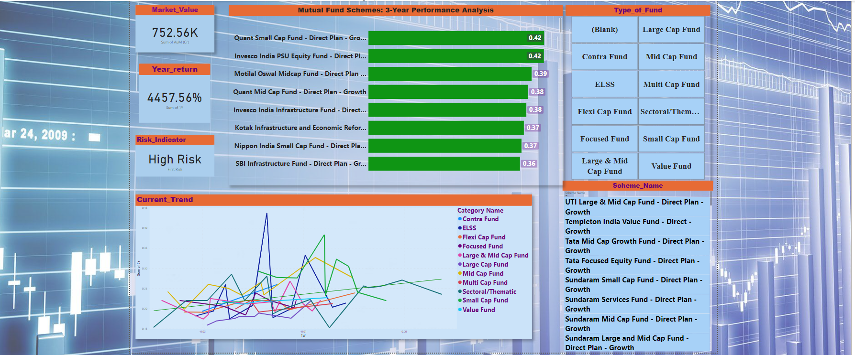
Dashboard Overview and Features :

Slide 9
Q&A:
- Open the floor for questions

